Slide 1
UNSUPERVISED

Slide 2
Tasks
 | Output = continuous | Output = discrete
Supervised | Regression | Classification
Unsupervised | Dimensionality reduction | Clustering
Solutions
Hierarchical,
Non-linear Model
Deep NN
SVR/SVM,
NN
Non-linear Model
Linear Model

Slide 3
Tasks
 | Output = continuous | Output = discrete
Supervised | Regression | Classification
Unsupervised | Dimensionality reduction | Clustering
Solutions
Hierarchical,
Non-linear Model
Deep NN
Bayes, Logistic
SVR/SVM,
NN
Non-linear Model
kNN, NN,
Perceptron
Linear Regression
Linear Model
K-means
PCA

Slide 4
DIMENSIONALITY REDUCTION: PCA

Slide 5
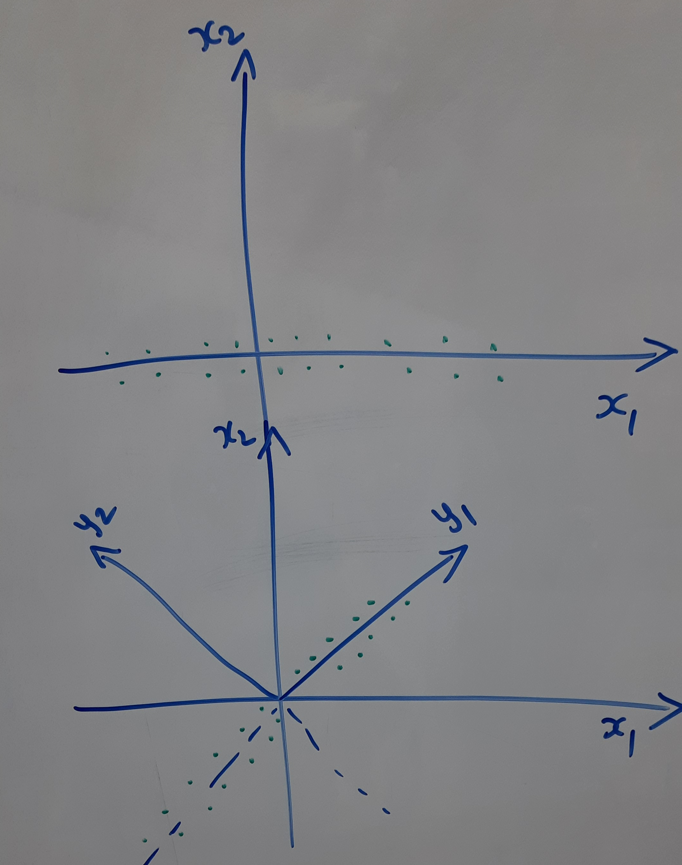
Principle
Given: A set of N points in D (say D = 2) dimensions
Can we project these points into M (say M = 1) dimension where M<D
Logic: Retain the valuable dimensions
Example: Remove Redundant dimension
Example: Pick dimensions with maximum variation

Slide 7
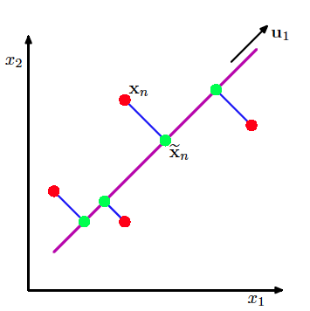
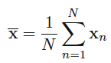
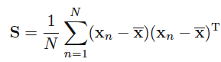
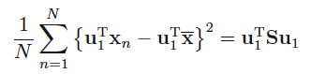
PCA: seeks a dimension along which variation is maximum

Slide 9
PCA: seeks a dimension along which variation is maximum

Slide 10
PCA: seeks a dimension along which variation is maximum
Welcome to
Constrained optimisation
One equality constraint

Slide 11
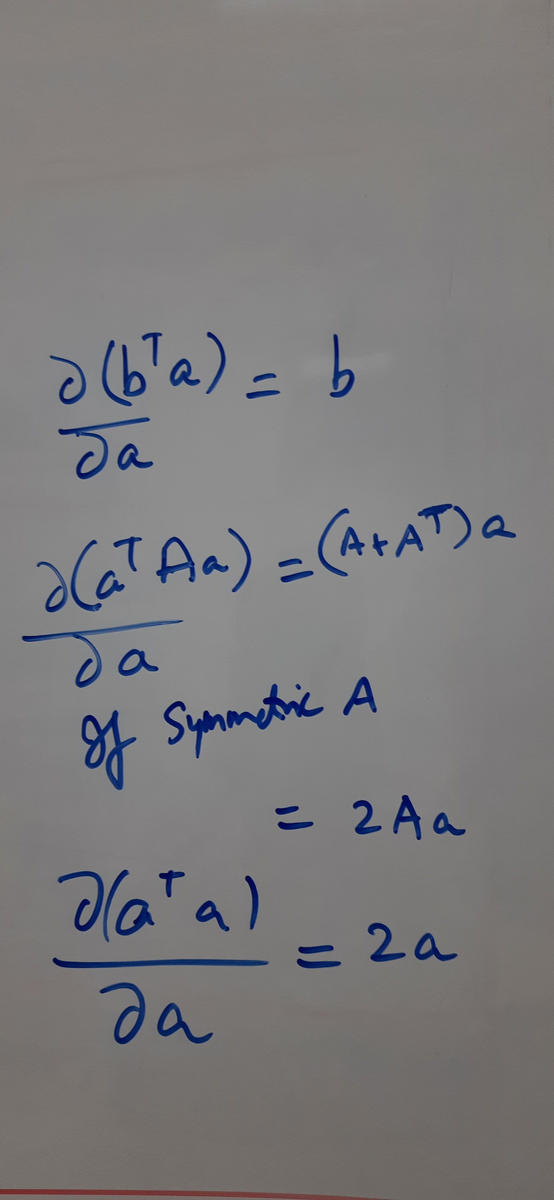
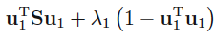
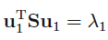
PCA: seeks a dimension along which variation is maximum
$$L(u_{1},λ_{1})$$
Lagrangian, new cost function
Welcome to
Constrained optimisation

Slide 12
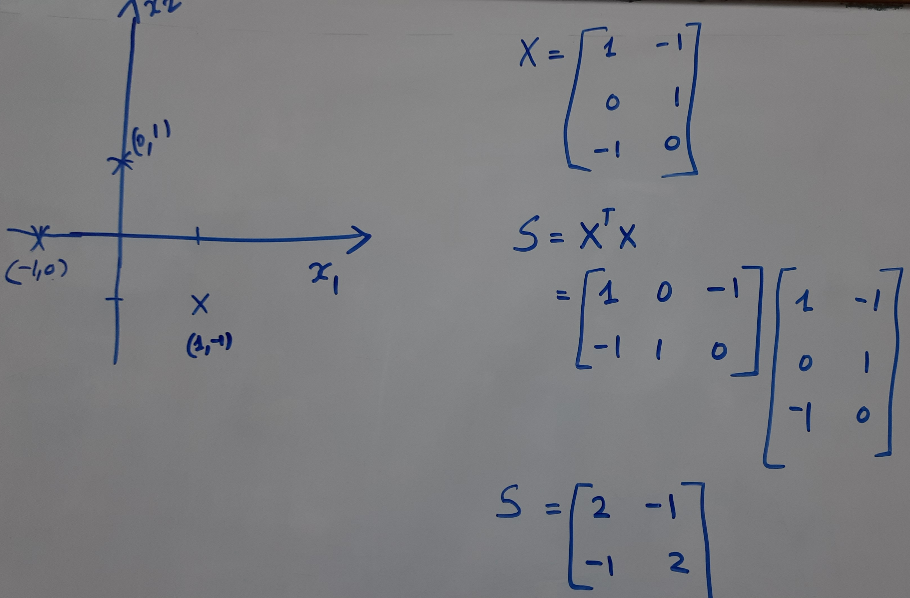
PCA: Numerical ILLUSTRATION

Slide 13
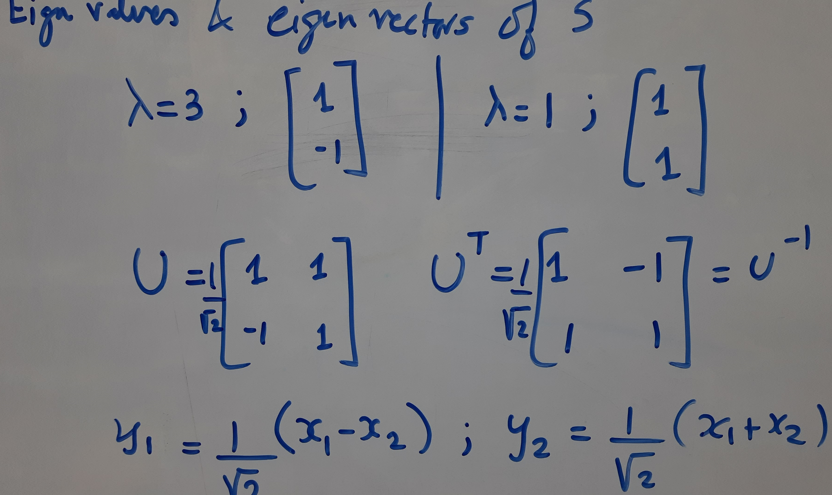

Slide 14
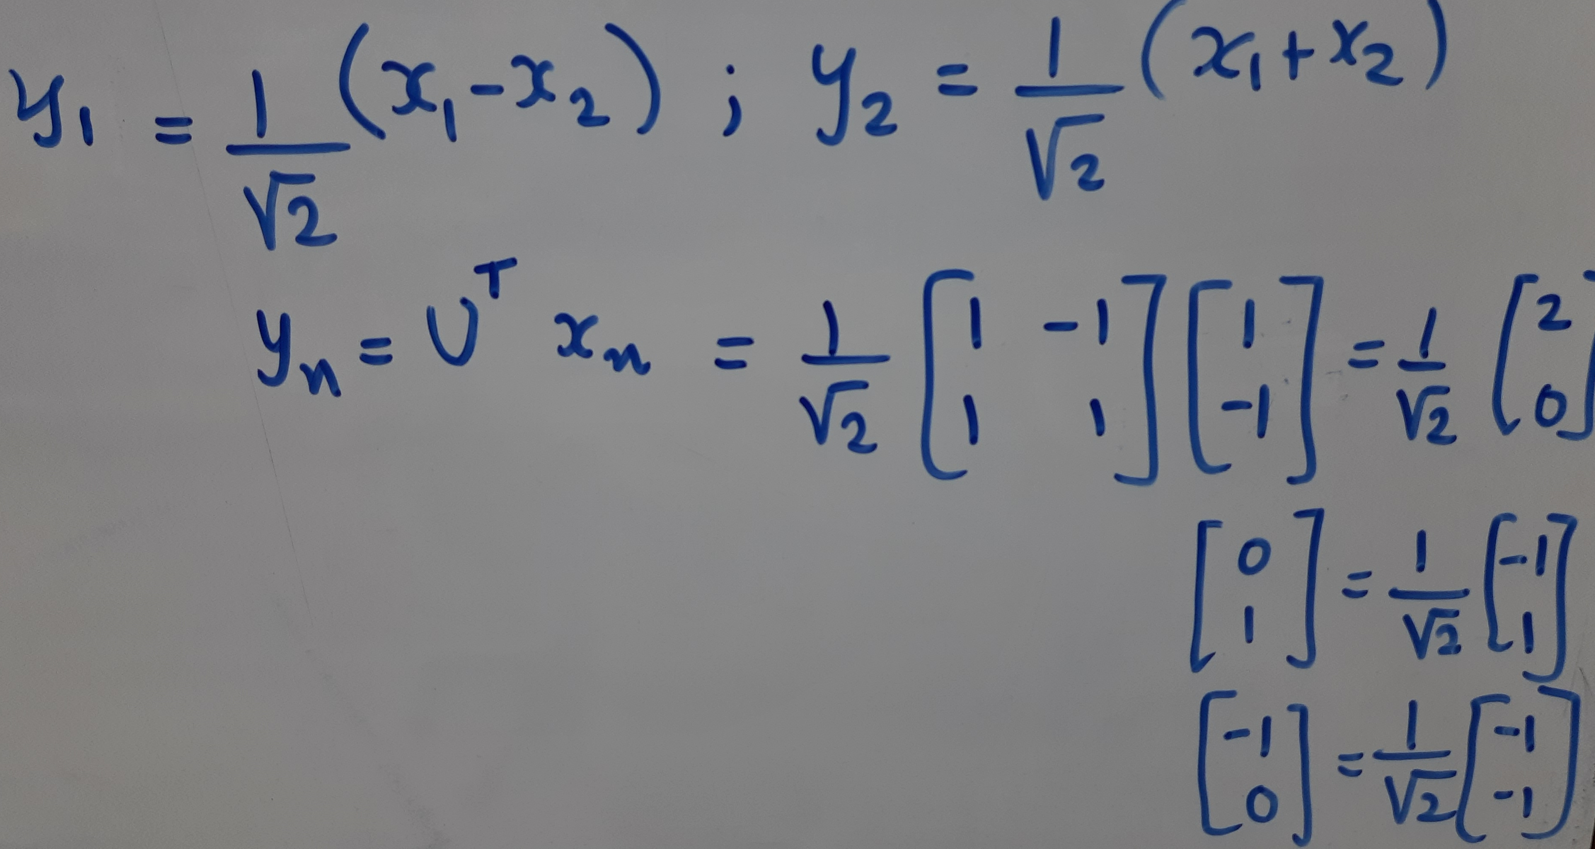
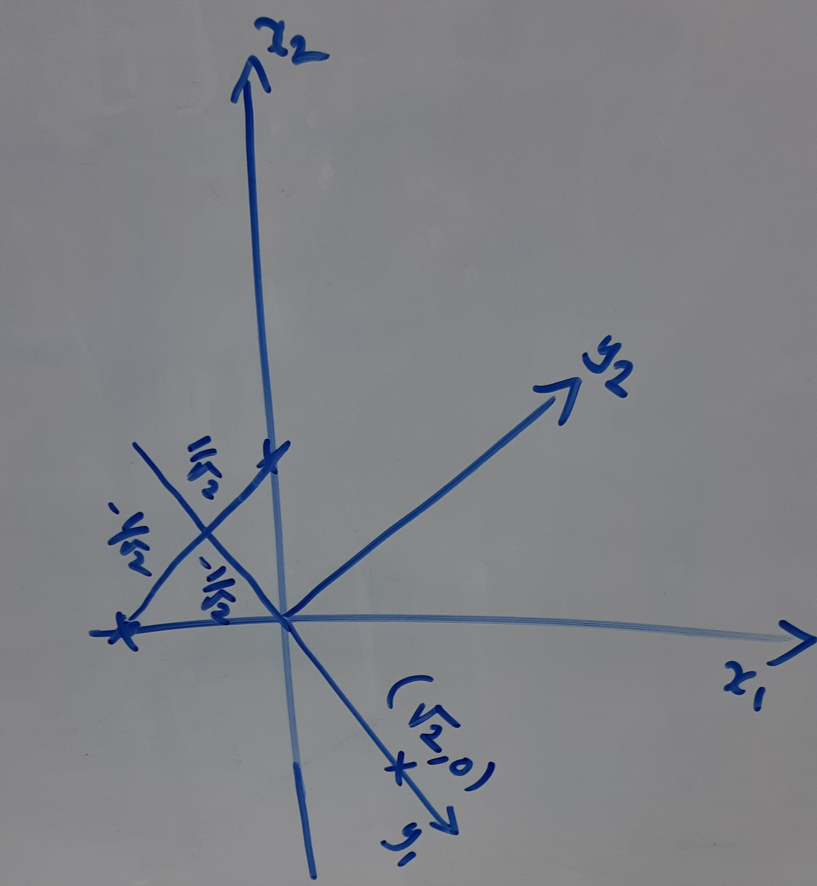

Slide 15
Applications: for fun, not included for Quiz 2

Slide 16
Face Recognition: PCA

Slide 17
Intra class variation challenge

Slide 18
PCA

Slide 19
PCA

Slide 20
Object Recognition
Source: CVML – Andrew Zisserman

Slide 21
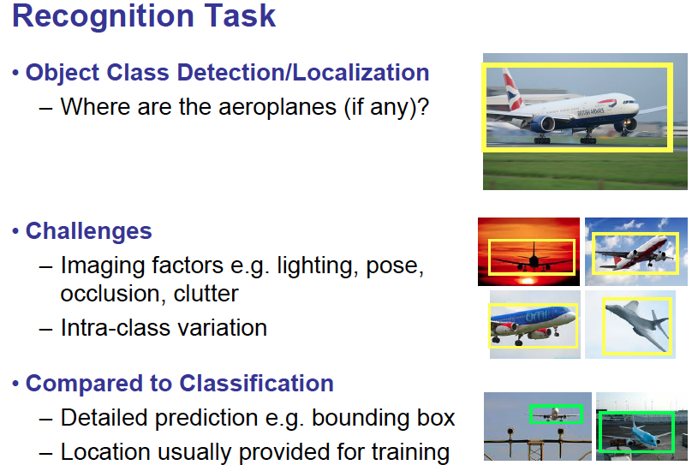

Slide 22
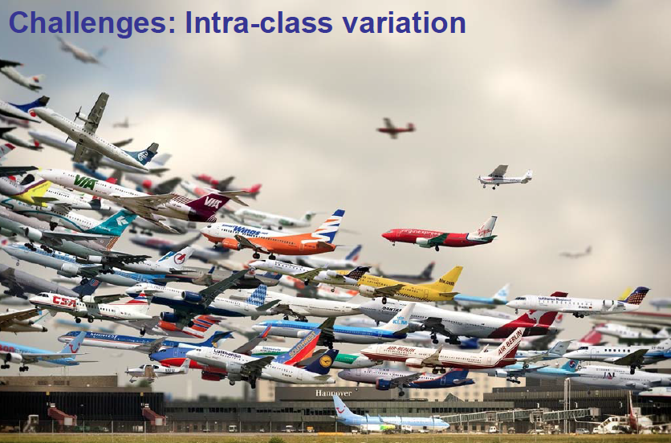

Slide 23
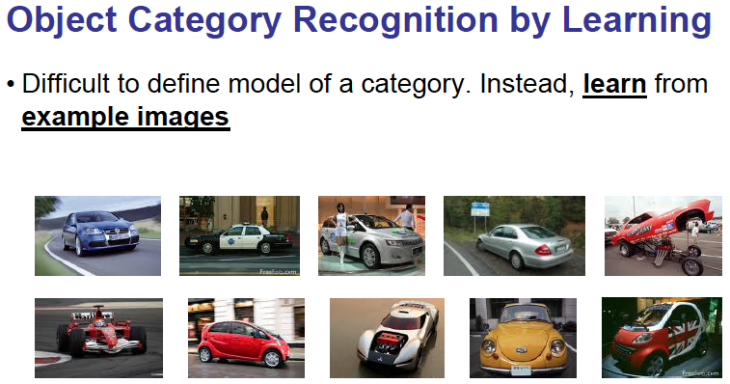

Slide 24
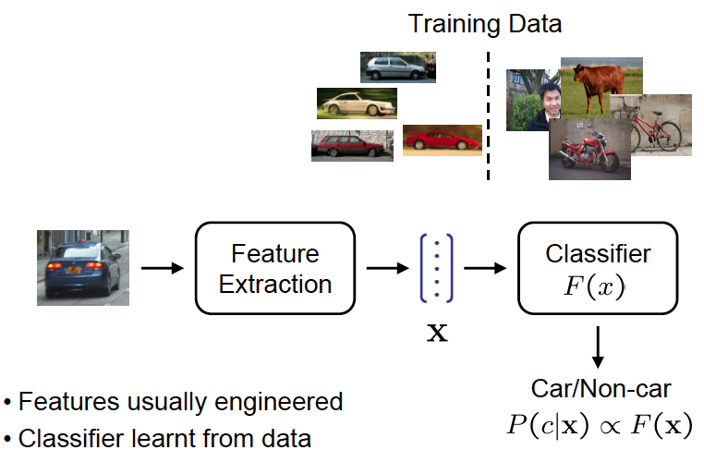
Object Recognition - summary

Slide 25
Extract interest points and descriptors for every image
Cluster centers
K- Means Clustering

Slide 26
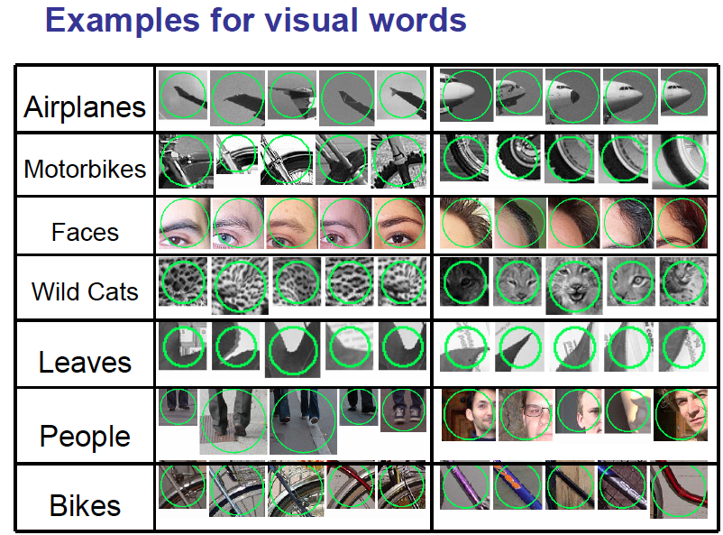

Slide 27
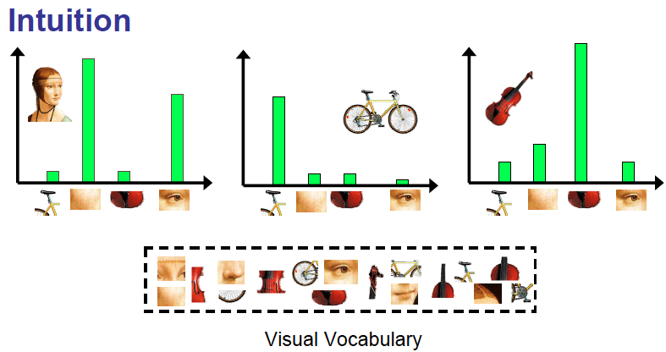
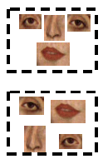
Object recognition

Slide 28
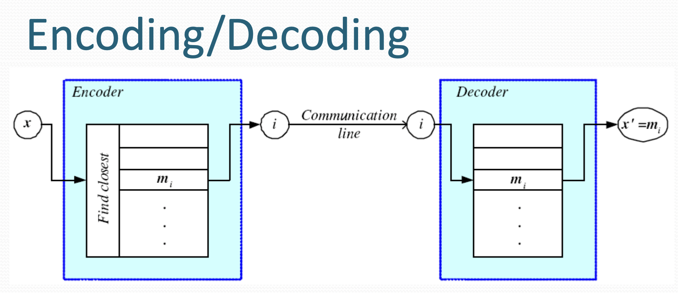

Slide 29
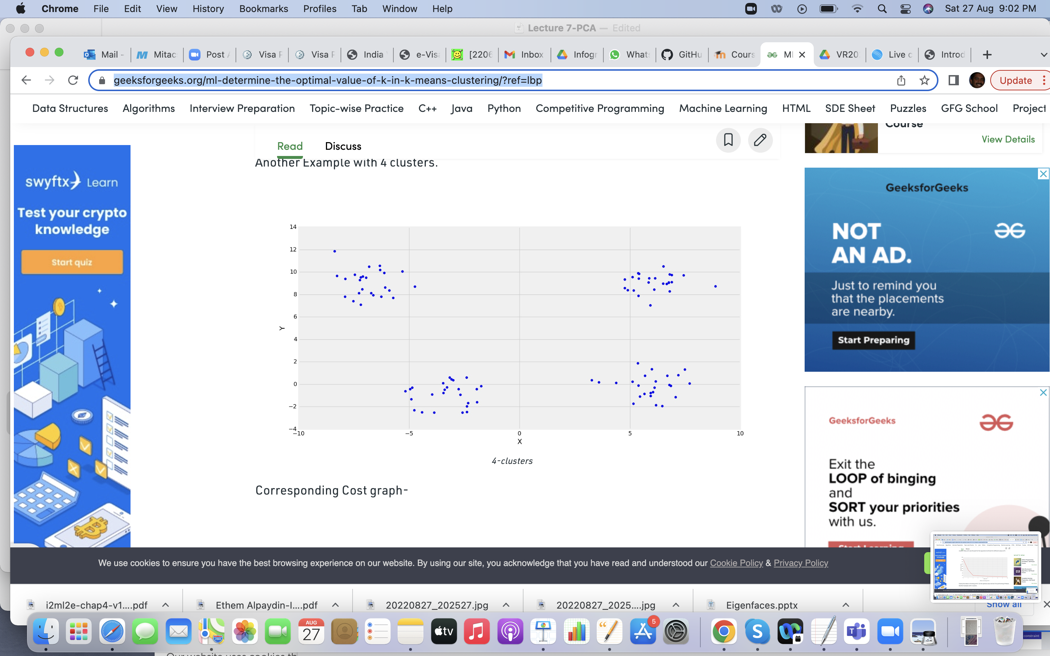
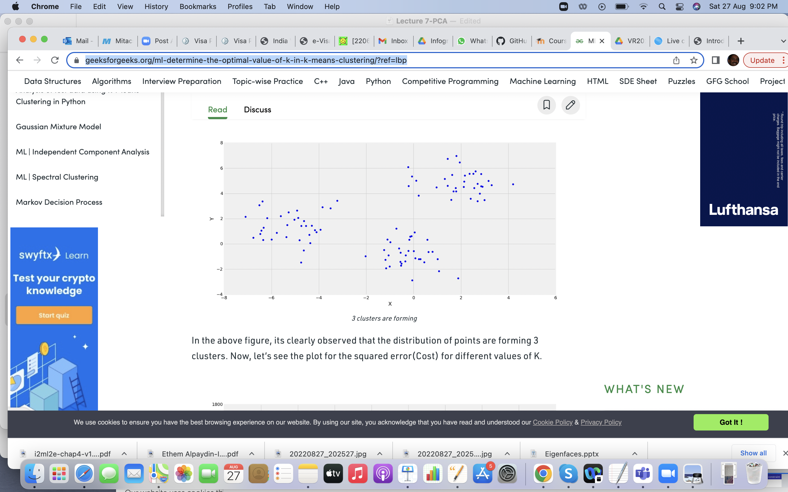
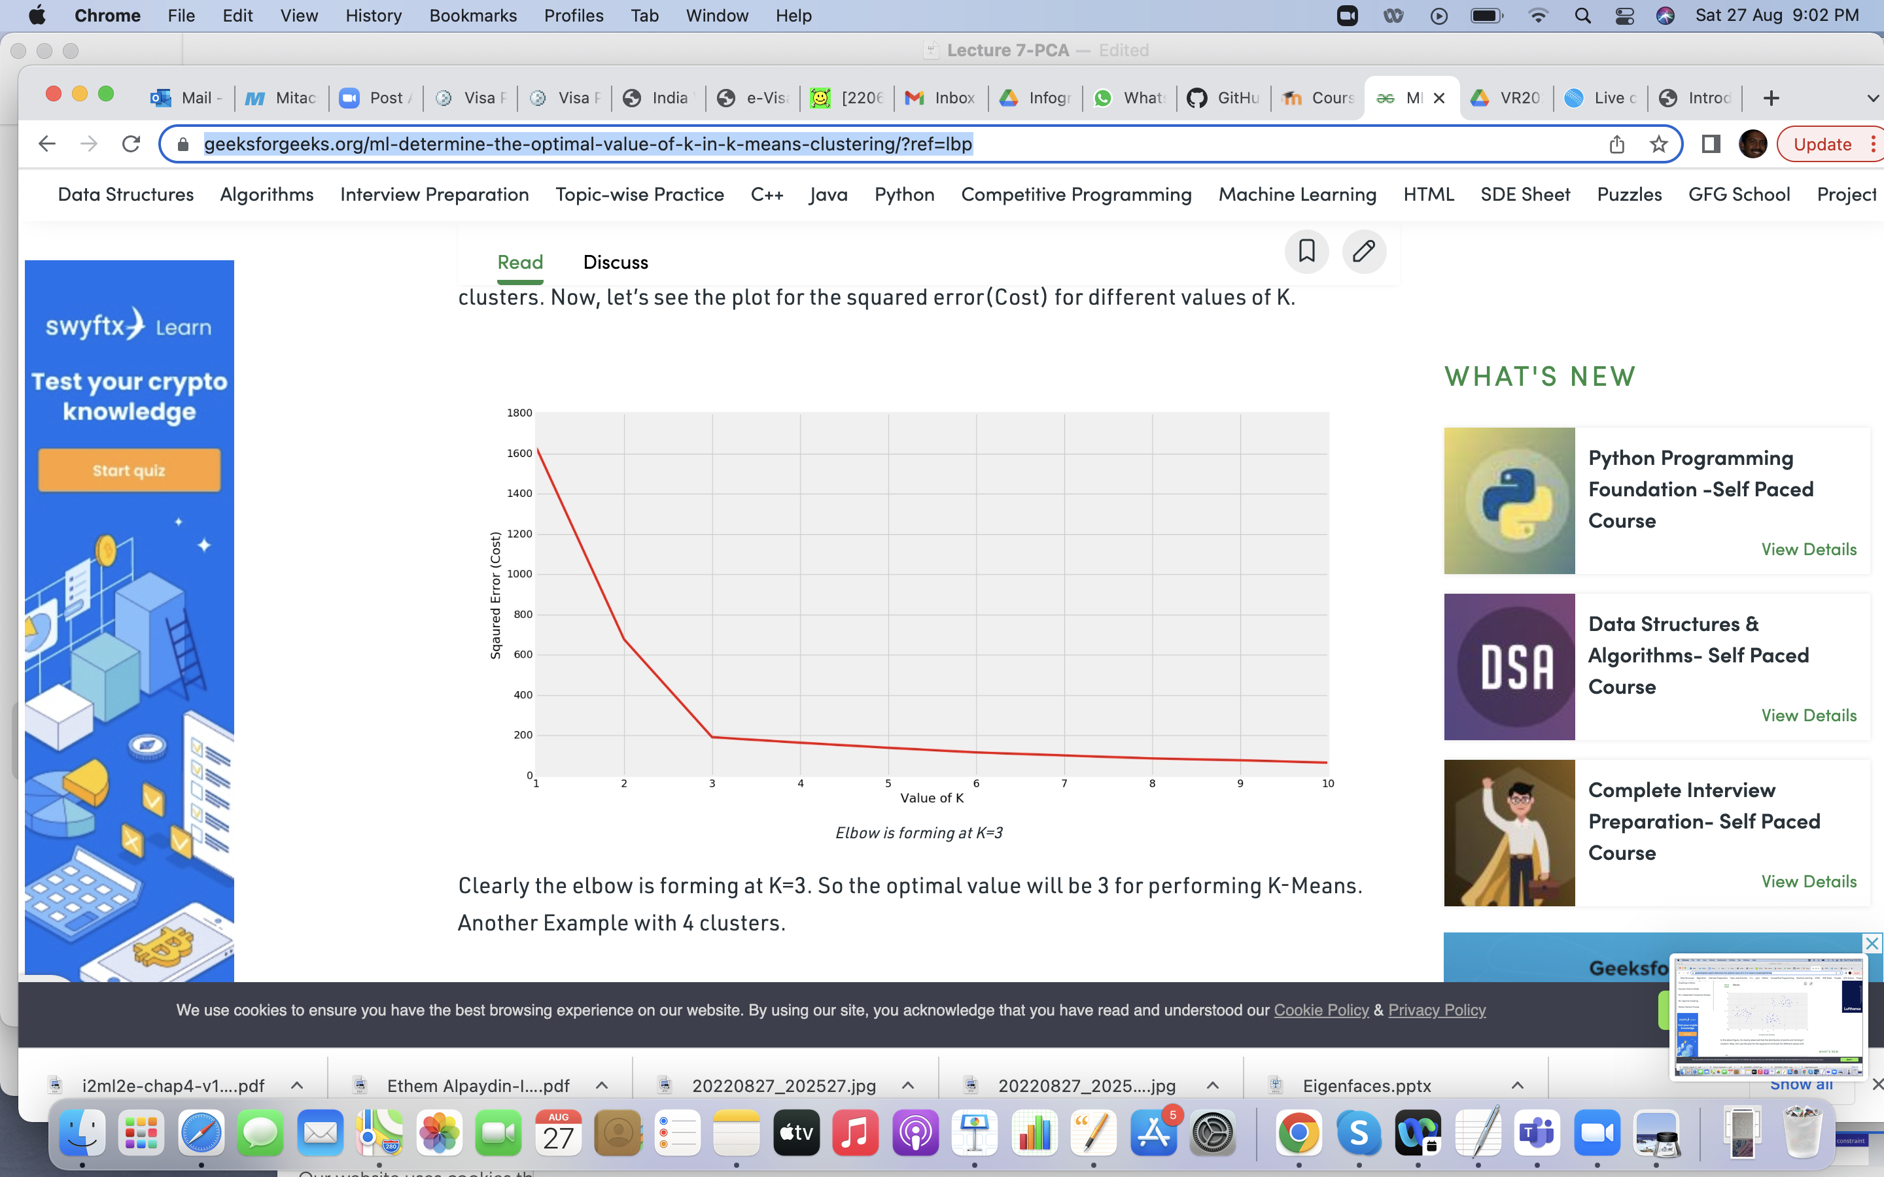
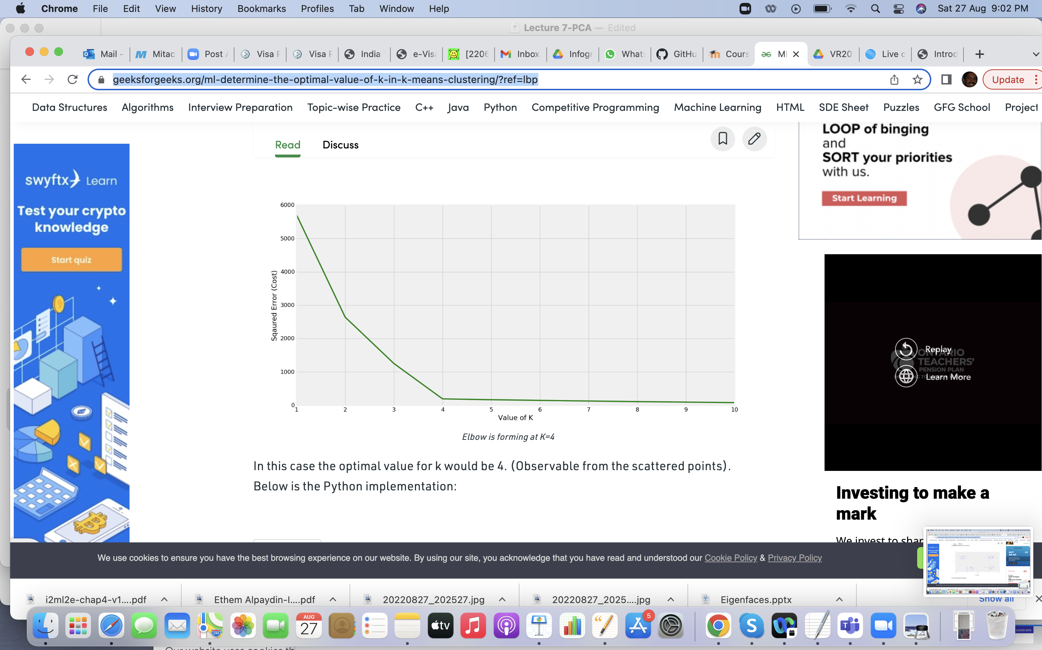
https://www.geeksforgeeks.org/ml-determine-the-optimal-value-of-k-in-k-means-clustering/?ref=lbp

